Slide 1
Machine Learning
Presented by: Eng Mona Qasem

Slide 2

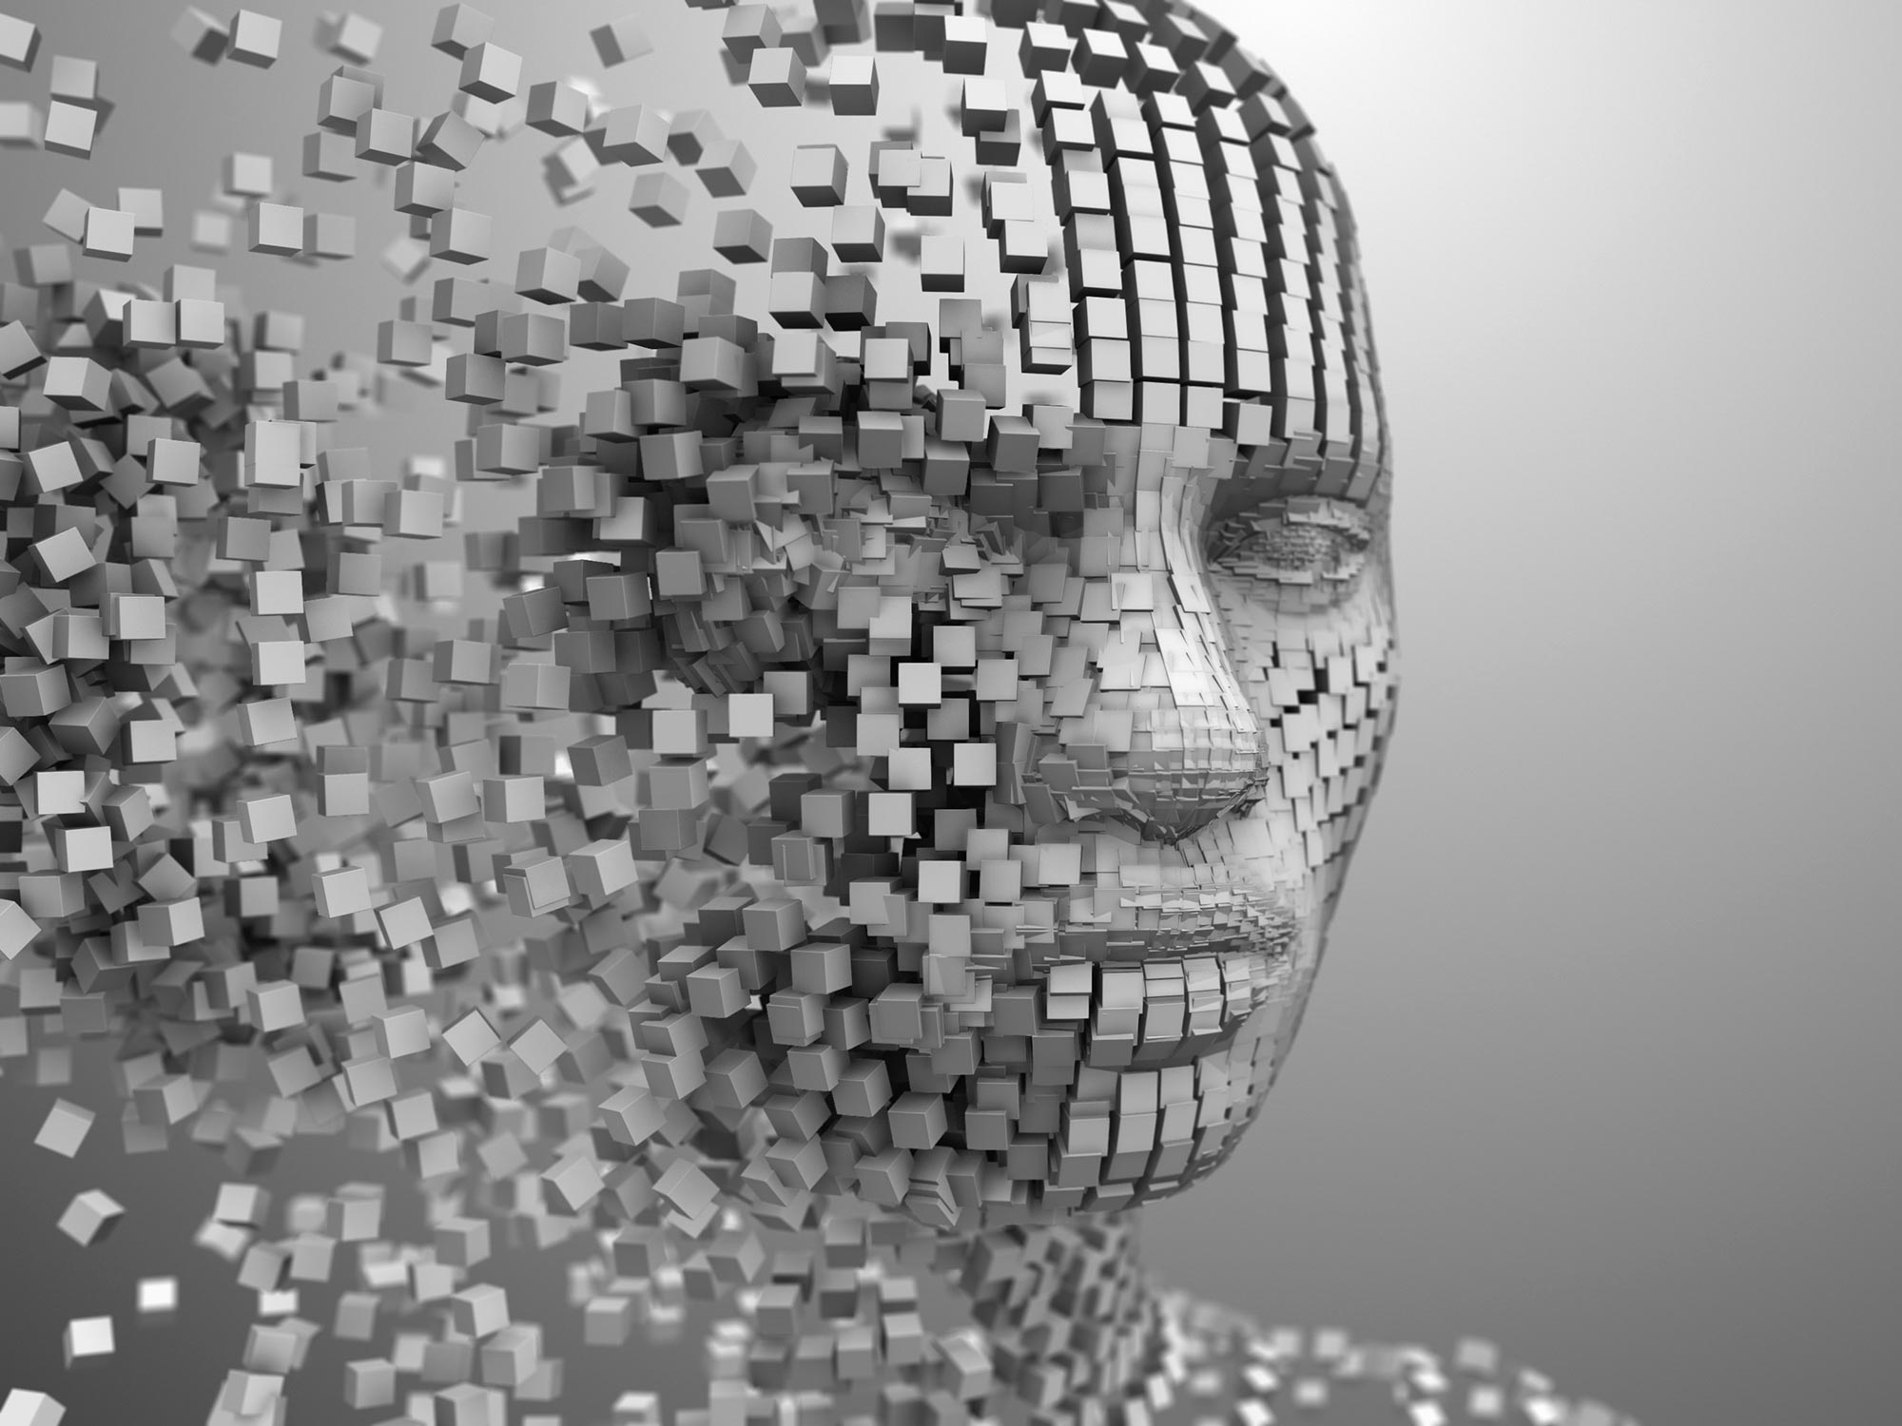
What is Artificial Intelligence?

Slide 3
What is Artificial Intelligence?
Artificial intelligence (AI) is the ability of a computer or a robot controlled by a computer to do tasks that are usually done by humans because they require human intelligence and discernment.

Slide 4
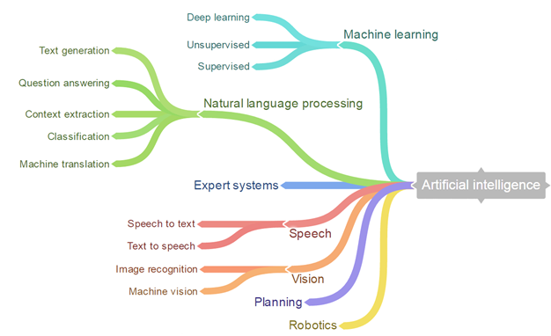
Branches of AI

Slide 5
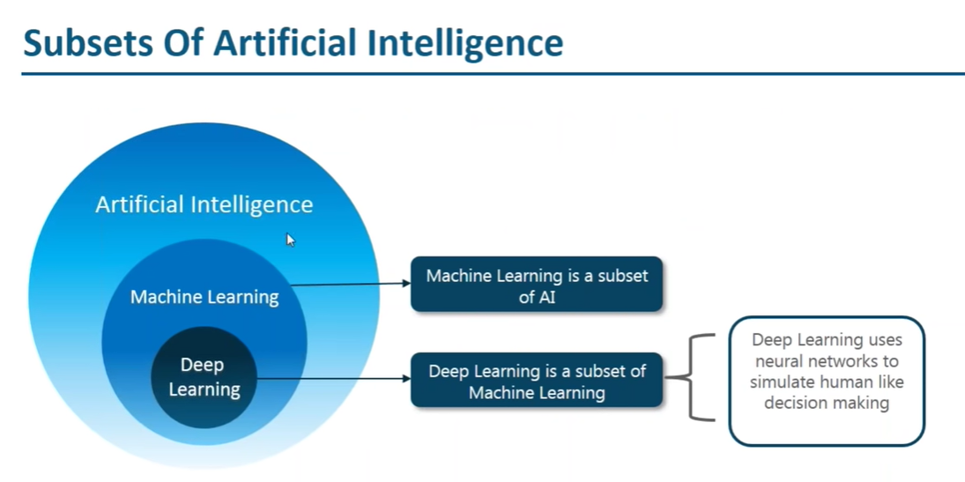

Slide 6
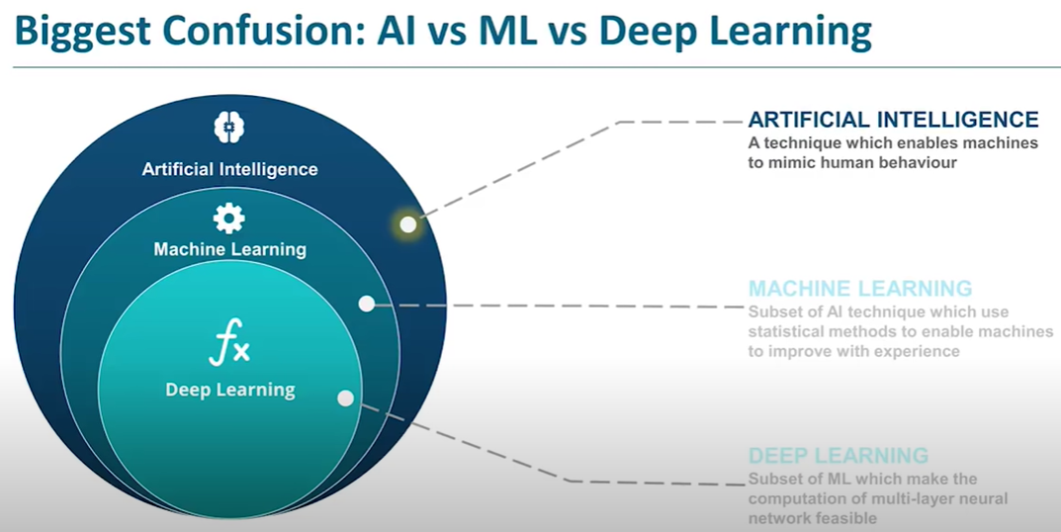

Slide 7
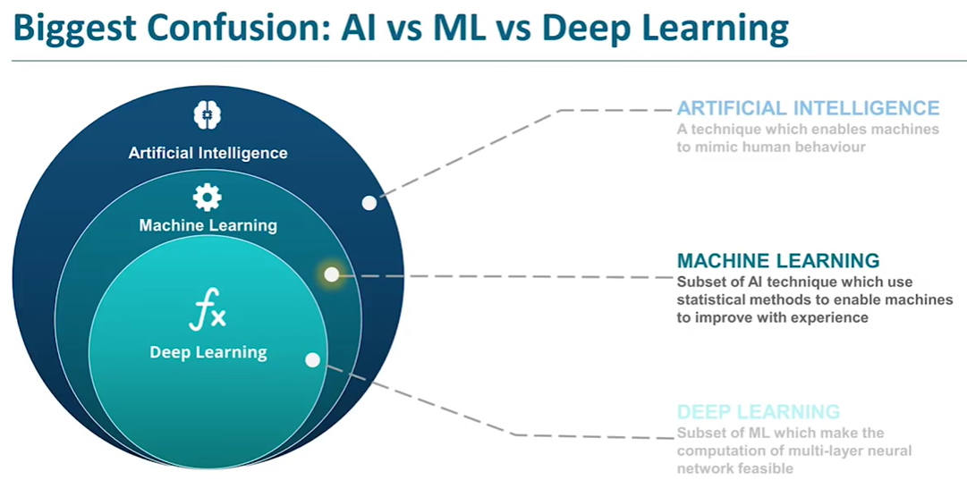

Slide 8
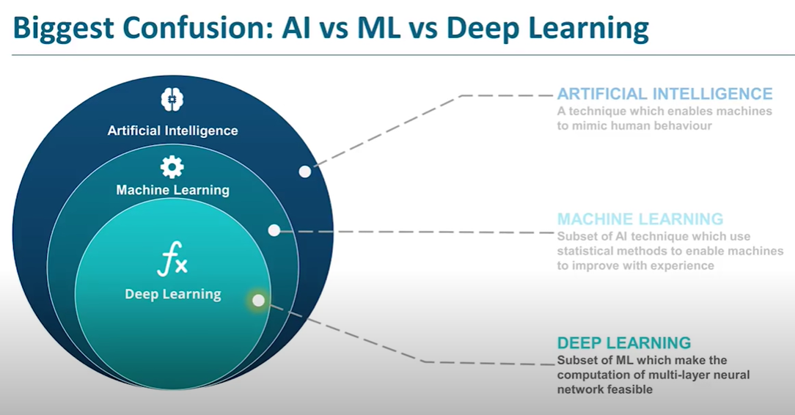

Slide 9
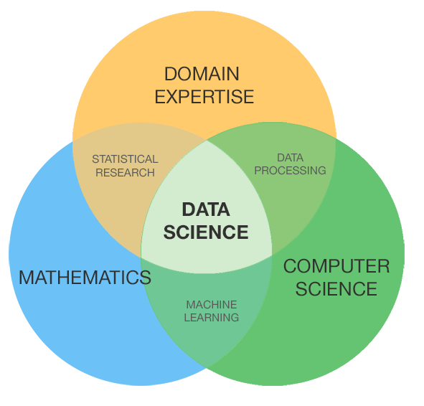
What is Data Science?

Slide 10
Data Science
Is the computational science of extracting meaningful insights from raw data and then effectively communicating those insights to generate value.

Slide 11
Machine Learning
Machine learning is a field of inquiry devoted to understanding and building methods that 'learn', that is, methods that leverage data to improve performance on some set of tasks. It is seen as a part of artificial intelligence

Slide 12
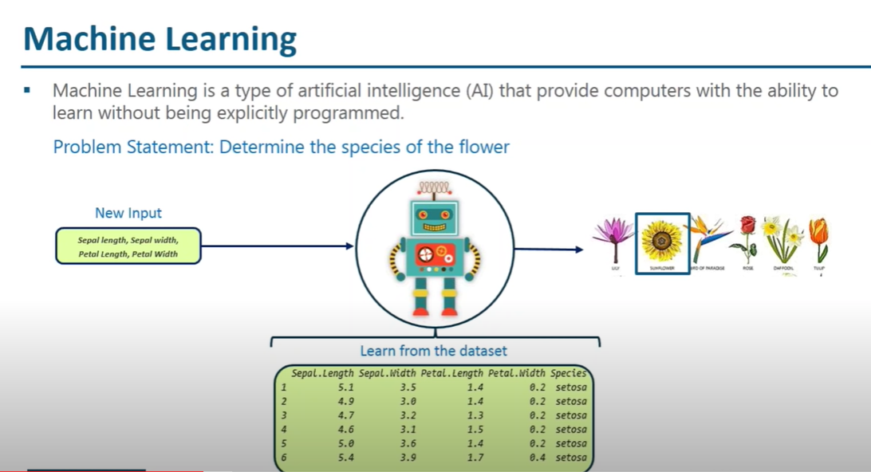

Slide 13
Machine Learning: Learning from Data with Your Machine
Machine learning is the practice of applying algorithmic models to data, in an iterative manner, so that your computer discovers hidden patterns or trends that you can use to make predictions.
Machine learning has a vast and ever-expanding assortment of use cases, including:
Real-time Internet advertising
Internet marketing personalization
Internet search
Spam filtering
Recommendation engines
Natural language processing and sentiment analysis
Automatic facial recognition

Slide 14
Walking through the steps of the machine learning process
Three main steps are involved in machine learning: setting up, learning, and application.
Setting up involves acquiring data, pre-processing it, feature selection (the process of selecting the most appropriate variables for the task at hand), and breaking the data into training and test datasets.
You use the training data to train the model, and the test data to test the accuracy of the model’s predictions.
The learning step involves model experimentation, training, building, and testing.
The application step involves model deployment and prediction.

Slide 15
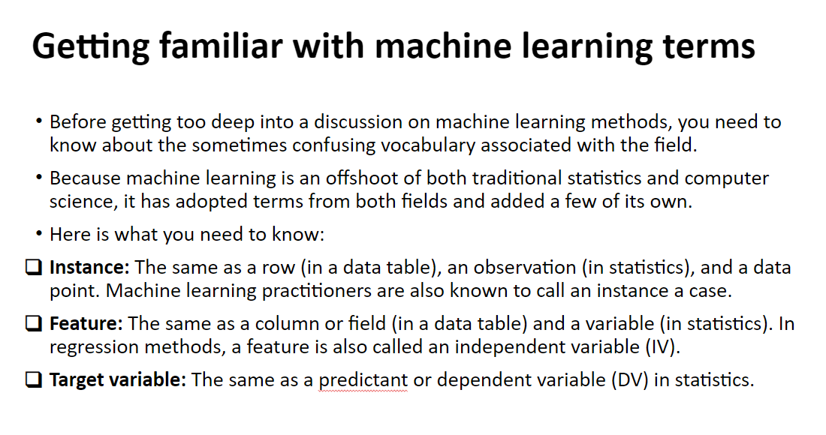

Slide 16
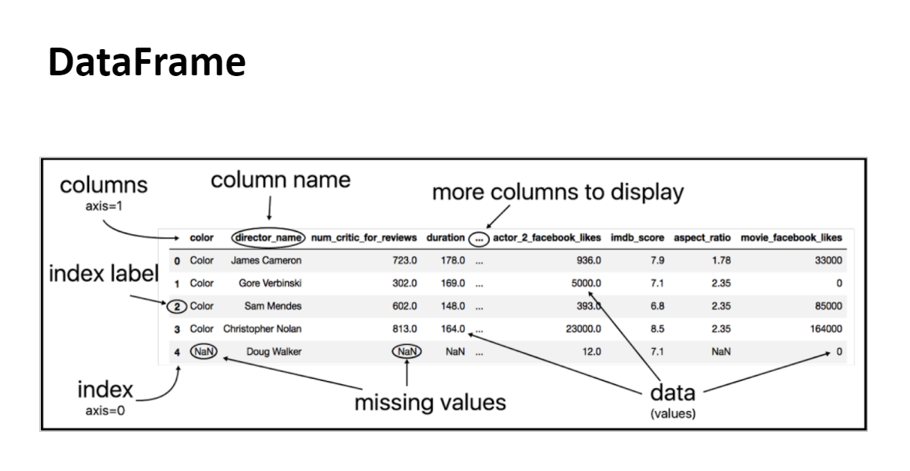

Slide 17
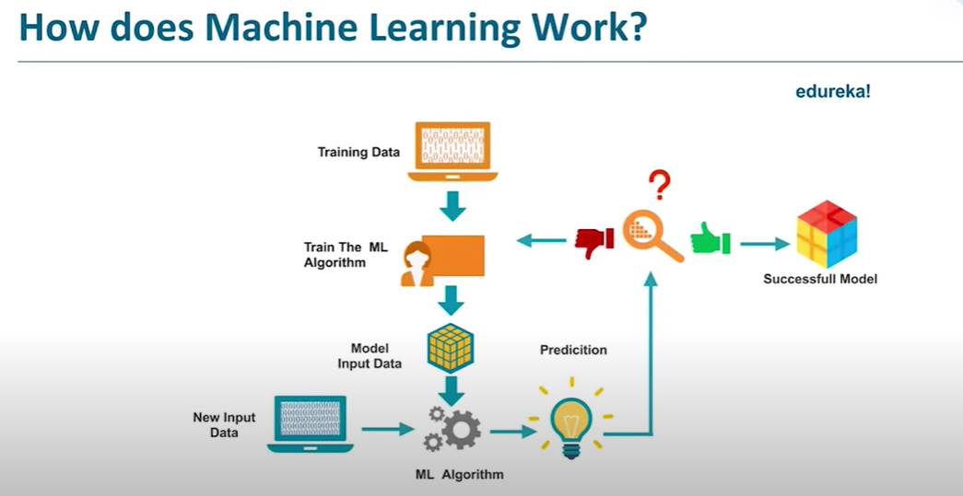

Slide 18
Example

Slide 19
Considering Learning Styles
There are three main styles within machine learning: supervised, unsupervised, and semi-supervised.
Supervised and unsupervised methods are behind most modern machine learning applications, and semi-supervised learning is an up-and-coming star.

Slide 20
Learning with supervised algorithms
Supervised learning algorithms require that input data has labelled features.
These algorithms learn from known features of that data to produce an output model that successfully predicts labels for new incoming, unlabelled data points.
You use supervised learning when you have a labelled dataset composed of historical values that are good predictors of future events.
Use cases include survival analysis and fraud detection, among others.
Logistic regression is a type of supervised learning algorithm.

Slide 21
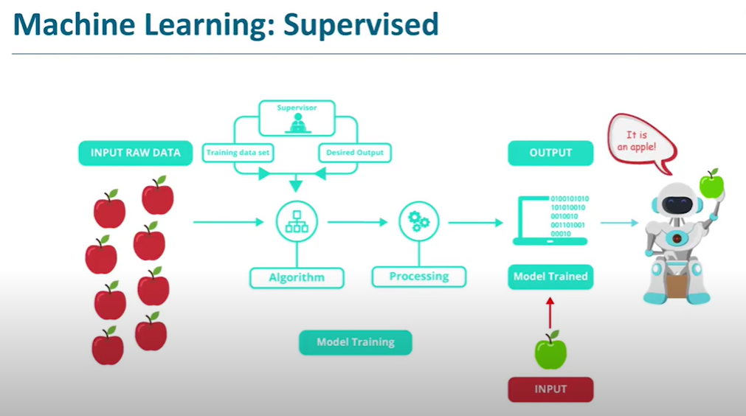

Slide 22
Example

Slide 23
Learning with unsupervised algorithms
Unsupervised learning algorithms accept unlabelled data and attempt to group observations into categories based on underlying similarities in input features, as shown in figure next slide.
Principal component analysis, k-means clustering, and singular value decomposition are all examples of unsupervised machine learning algorithms.
Popular use cases include recommendation engines, facial recognition systems, and customer segmentation.

Slide 24
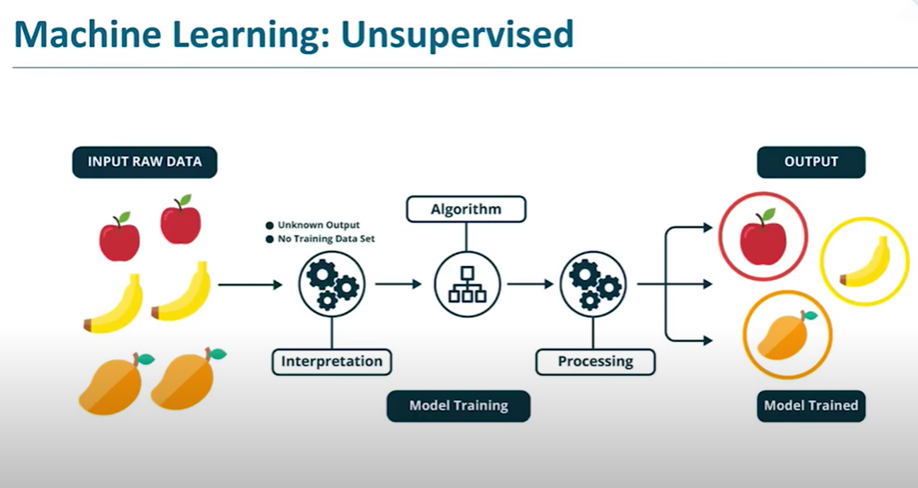

Slide 25
Example

Slide 26
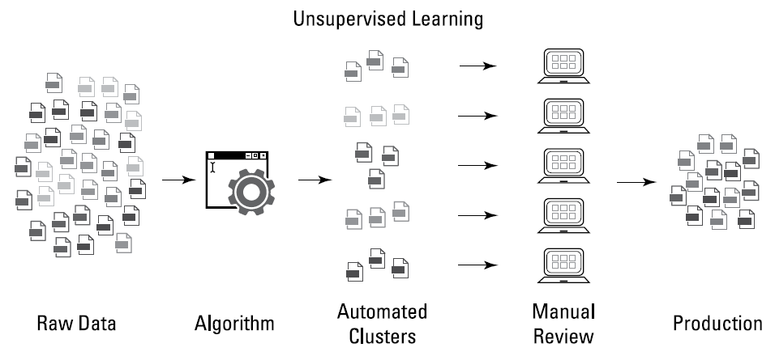
Unsupervised machine learning breaks down unlabelled data into subgroups

Slide 27
Example

Slide 28
Learning with reinforcement
Reinforcement learning (or semi-supervised learning) is a behaviour-based learning model.
It is based on a mechanic similar to how humans and animals learn.
The model is given “rewards” based on how it behaves, and it subsequently learns to maximize the sum of its rewards by adapting the decisions it makes to earn as many rewards as possible.
Reinforcement learning is an up-and-coming concept in data science.

Slide 29
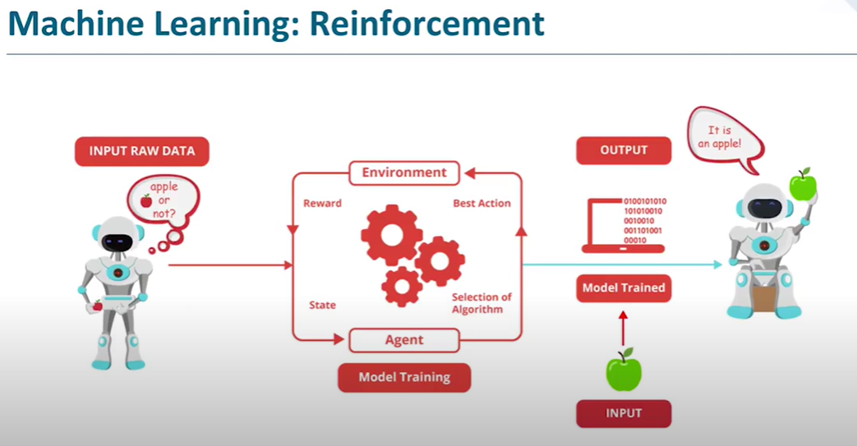

Slide 30
Example

Slide 31
Selecting algorithms based on function
When you need to choose a class of machine learning algorithms, it’s helpful to consider each model class based on its functionality.
For the most part, algorithmic functionality falls into the categories shown in figure next slide.

Slide 32
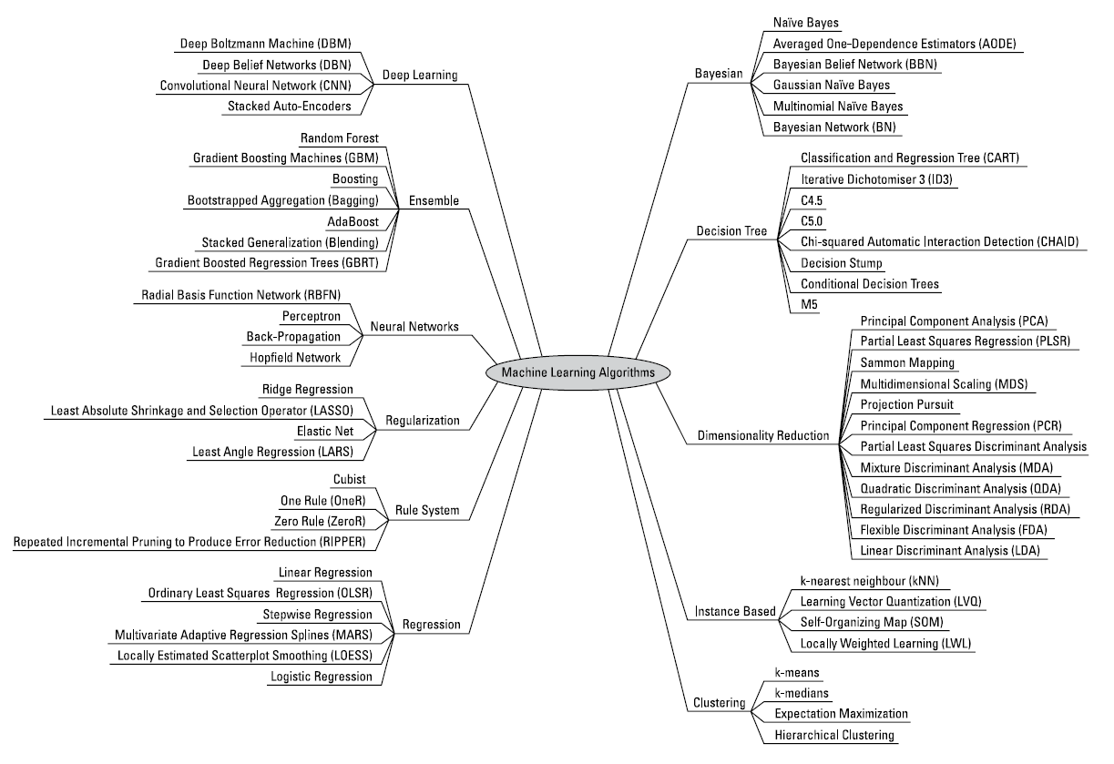

Slide 33
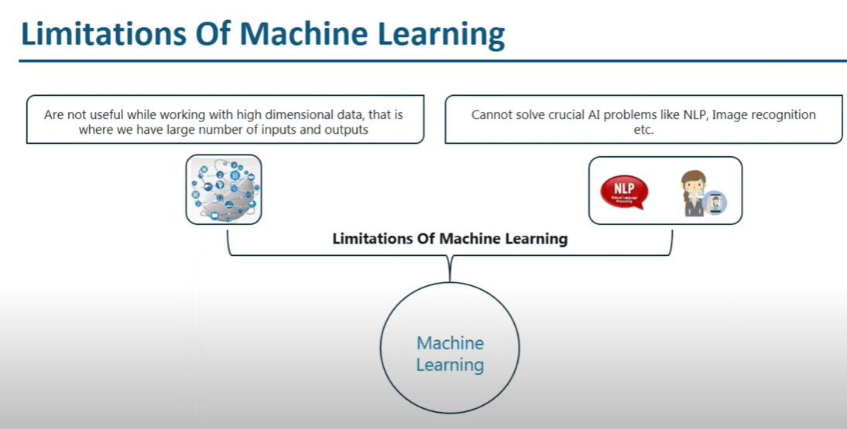

Slide 34
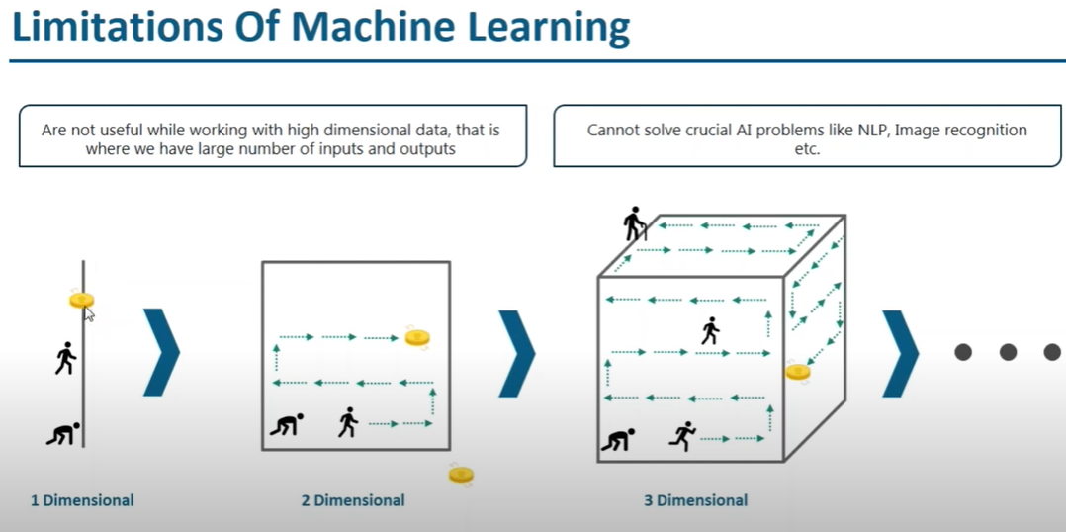

Slide 35
Deep learning

Slide 36
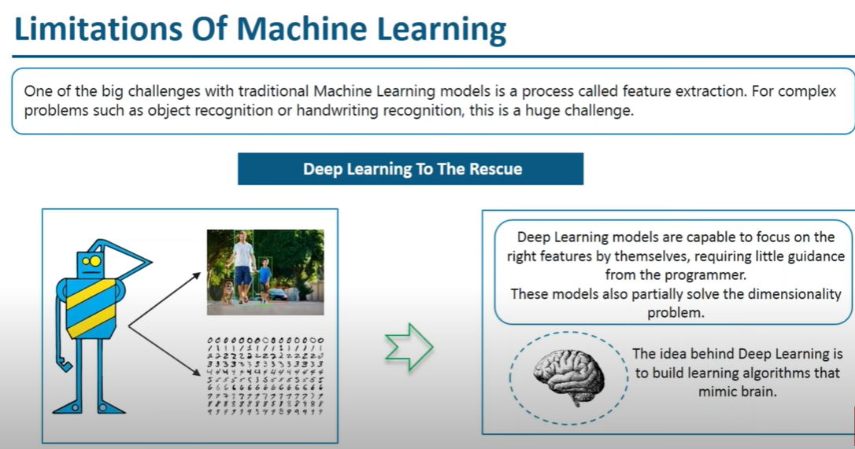

Slide 37
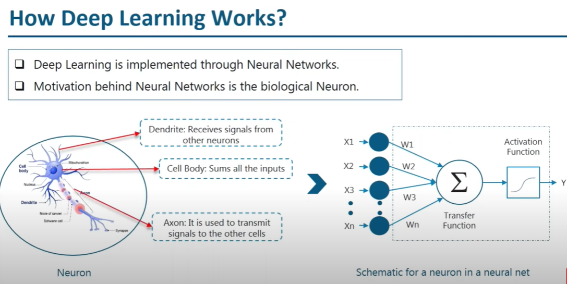

Slide 38
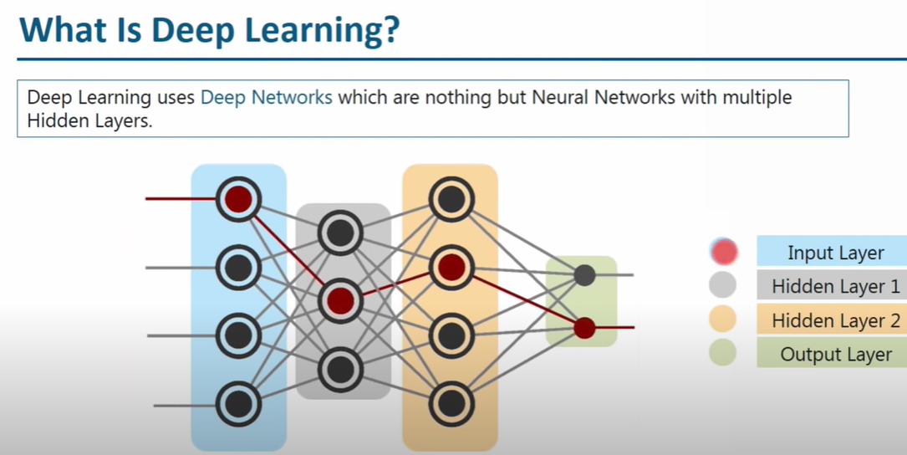

Slide 40
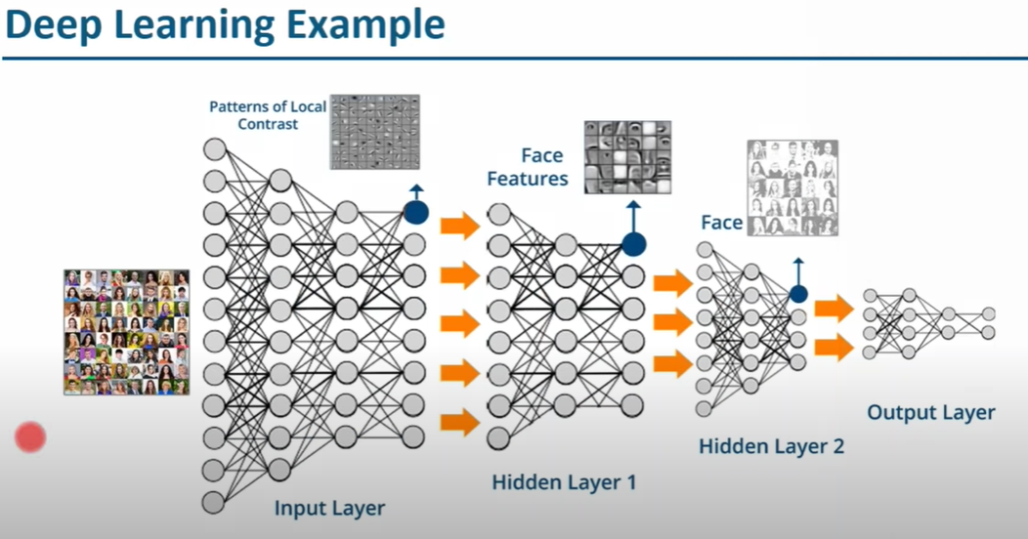

Slide 41
Neural network
A neural network mimics how the brain solves problems, by using a layer of interconnected neural units as a means by which to learn, and infer rules, from observational data.
Imagine that you’re deciding whether you should go to the beach.
You never go to the beach if it’s raining, and you don’t like going if it’s colder than 24 degrees outside.
These are the two inputs for your decision.
Your preference to not go to the beach when it’s raining is a lot stronger than your preference to not go to the beach when it is colder than 24 degrees, so you weight these two inputs accordingly.
For any given instance where you decide whether you’re going to the beach, you consider these two criteria, add up the result, and then decide whether to go.
If you decide to go, your decision threshold has been satisfied.
If you decide not to go, your decision threshold was not satisfied.
This is a simplistic analogy for how neural networks work.

Slide 42
Neural network – cont.
The simplest type of neural network is the Perceptron.
It accepts more than one input, weights them, adds them up on a processor layer, and then, based on the activation function and the threshold you set for it, outputs a result.
An activation function is a mathematical function that transforms inputs into an output signal.
The processor layer is called a hidden layer.
A neural network is a layer of connected Perceptrons that all work together as a unit to accept inputs and return outputs that signal whether some criteria is met.
A key feature of neural nets is that they are self-learning — in other words, they adapt, learn, and optimize per changes in input data.
Figure next slide is a schematic layout that depicts how a Perceptron is structured.

Slide 43
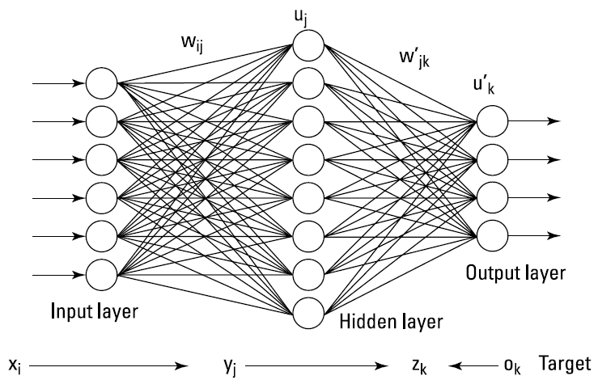
Neural networks are connected layers of artificial neural units

Slide 44
Deep learning (Deep neural networks)
Deep learning is a machine learning method that uses hierarchical neural networks to learn from data in an iterative and adaptive manner.
It’s an ideal approach for learning patterns from unlabelled and unstructured data.
It’s essentially the same concept as the neural network, except that deep learning algorithms have three or more hidden layers.
In fact, computer vision applications have been known to implement more than 150 hidden layers in a single deep neural network.
The more hidden layers there are, the more complex a decision the algorithm can make.
Figure next slide is a schematic layout that depicts how a deep learning network is structured.

Slide 45
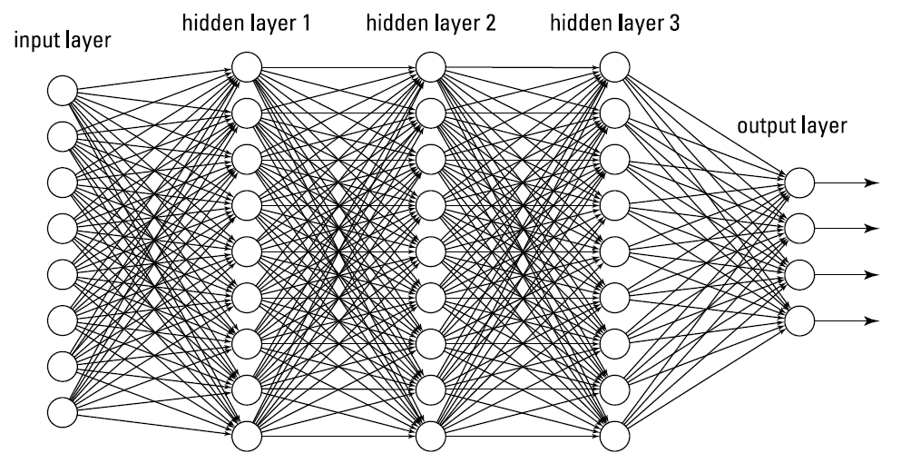
A deep learning network is a neural network with more than two hidden layer

Slide 46
Classification vs Regression problem
Example

Slide 47
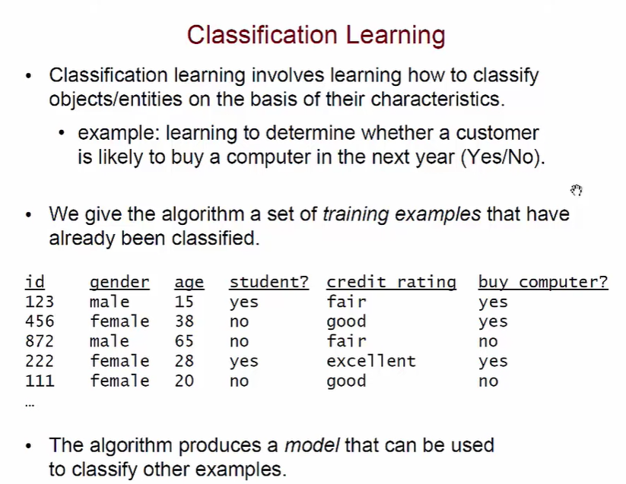

Slide 48
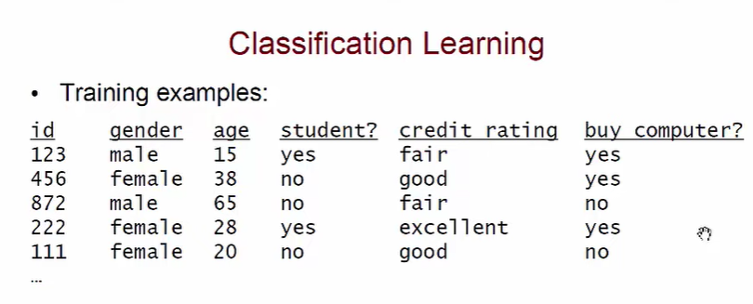
Female 25 no fair ????

Slide 49
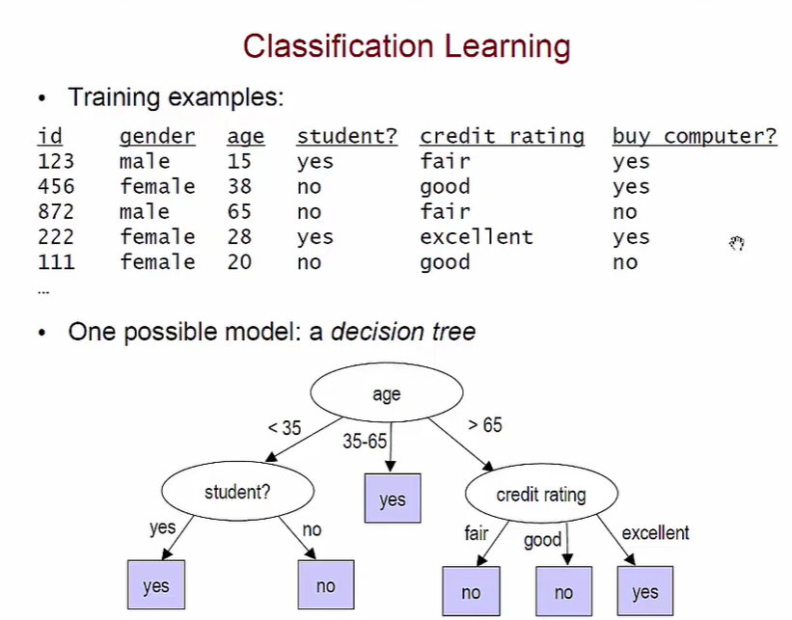
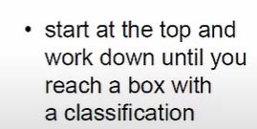

Slide 50
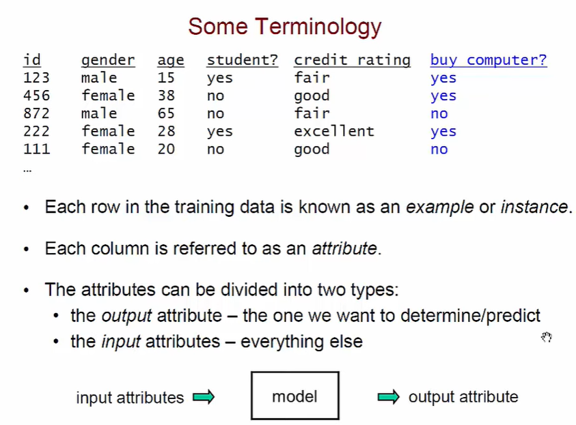

Slide 51
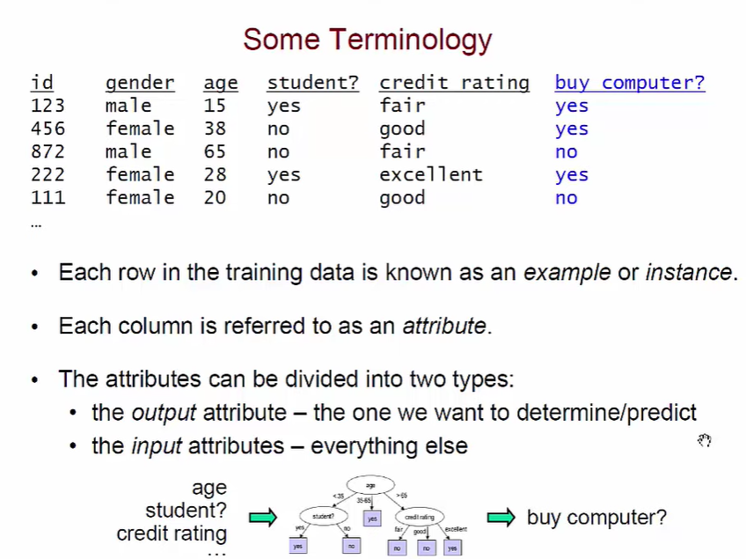

Slide 52
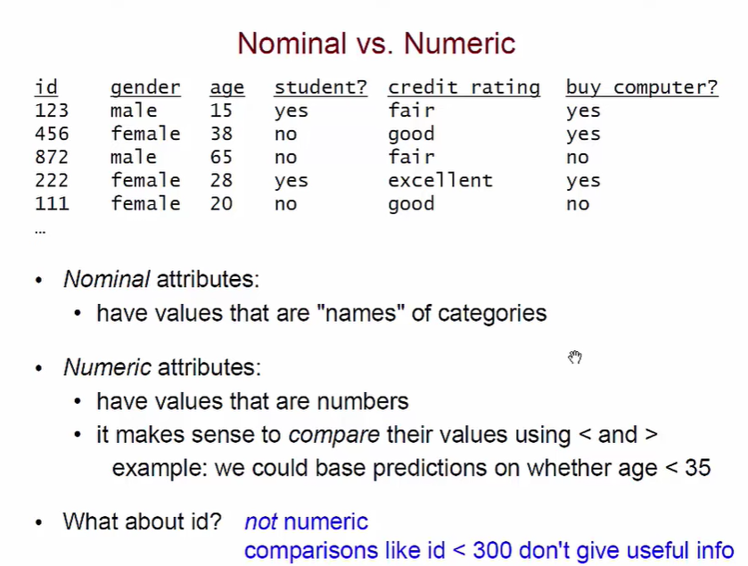

Slide 53
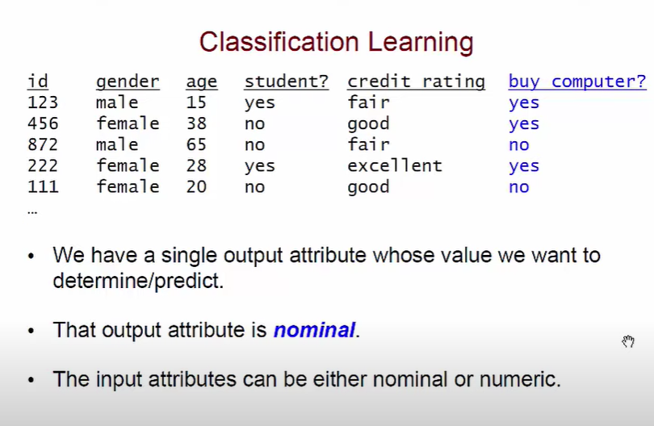

Slide 54
